Slide 1
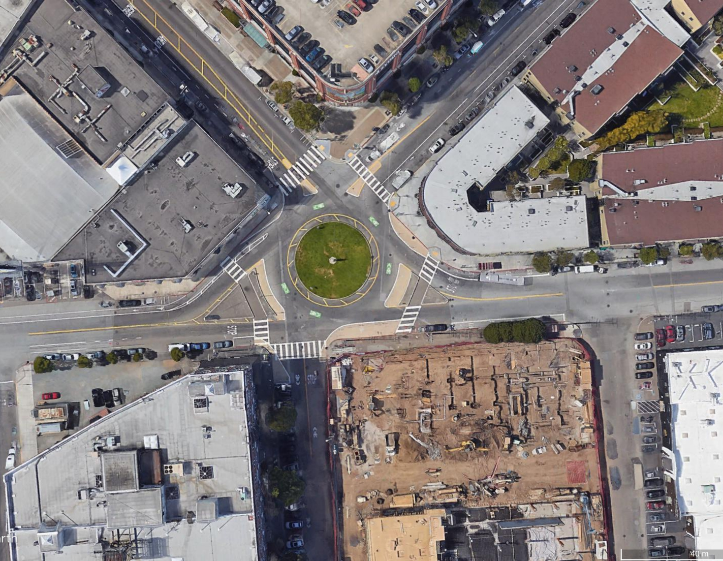
Townsend St
8th St
Division St
Division St
Henry Adams St

